Slide 1
Infix to Postfix conversion

Slide 2
Infix notation
Infix notation is the common arithmetic and logical formula notation, in which operators are written infix-style between the operands they act on
E.g. A + B

Slide 3
Postfix notation
In Postfix notation, the operator comes after the Operand.
For example, the Infix expression A+B will be written as AB+ in its Postfix Notation.
Postfix is also called ‘Reverse Polish Notation’

Slide 4
Prefix notation
In Prefix notation, the operator comes before the operand.
The Infix expression A+B will be written as +AB in its Prefix Notation.
Prefix is also called ‘Polish Notation’

Slide 5
Operator Precedence
Highest: Exponentiation(^)
Next Highest: Multiplication(*) and division(/)
Lowest: Addition (+) and subtraction(-)

Slide 6
Conversion from Infix to Postfix Algorithm
Step1
Scan the Infix expression from left to right for tokens (Operators, Operands & Parentheses) and perform the steps 2 to 5 for each token in the Expression

Slide 7
Algorithm
Step2
If token is operand, Append it in postfix expression
Step3
If token is a left parentheses “(“, push it in stack.

Slide 8
Algorithm
Step4
If token is an operator,
Pop all the operators which are of higher or equal precedence then the incoming token and append them (in the same order) to the output Expression.
After popping out all such operators, push the new token on stack.

Slide 9
Algorithm
Step5
If “)” right parentheses is found,
Pop all the operators from the Stack and append them to Output String, till you encounter the Opening Parenthesis “(“.
Pop the left parenthesis but don’t append it to the output string (Postfix notation does not have brackets).

Slide 10
Algorithm
Step6
When all tokens of Infix expression have been scanned. Pop all the elements from the stack and append them to the Output String.
The Output string is the Corresponding Postfix Notation.

Slide 11
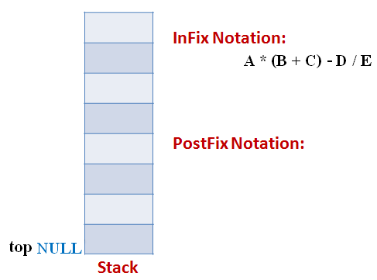
Example
Let the incoming the Infix expression be:
A * (B + C) – D / E
Stage 1: Stack is empty and we only have the Infix Expression.

Slide 12
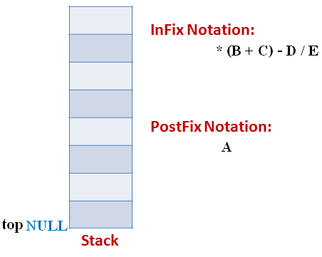
Example
Stage 2
The first token is Operand A Operands are Appended to the Output as it is.

Slide 13
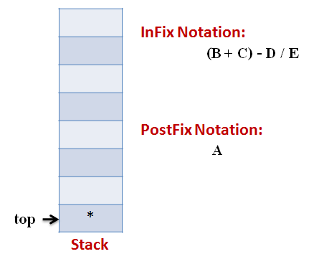
Example
Stage 3
Next token is * Since Stack is empty (top==NULL) it is pushed into the Stack

Slide 14
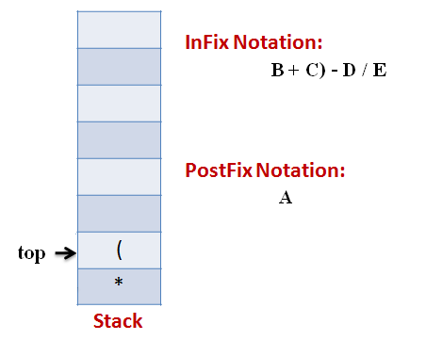
Example
Stage 4
Next token is ( the precedence of open-parenthesis, when it is to go inside, is maximum.
But when another operator is to come on the top of ‘(‘ then its precedence is least.

Slide 15
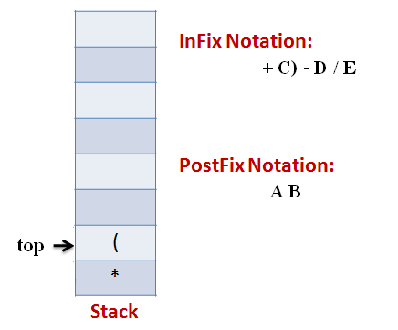
Example
Stage 5
Next token, B is an operand which will go to the Output expression as it is

Slide 16
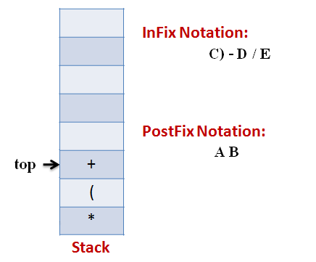
Example
Stage 6
Next token, + is operator, We consider the precedence of top element in the Stack, ‘(‘. The outgoing precedence of open parenthesis is the least (refer point 4. Above). So + gets pushed into the Stack

Slide 17
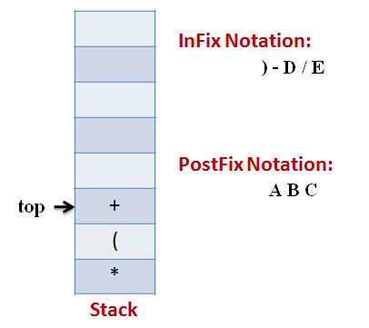
Example
Stage 7
Next token, C, is appended to the output

Slide 18
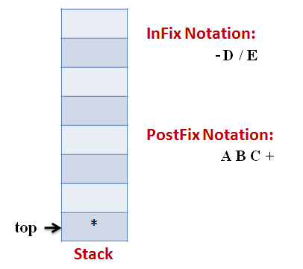
Example
Stage 8
Next token ), means that pop all the elements from Stack and append them to the output expression till we read an opening parenthesis.

Slide 19
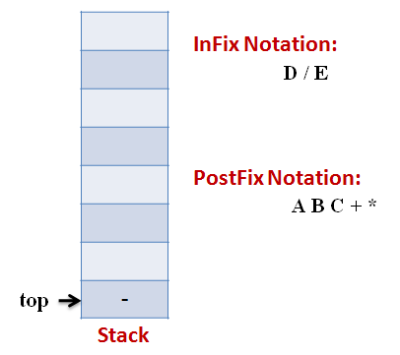
Example
Stage 9
Next token, -, is an operator. The precedence of operator on the top of Stack ‘*‘ is more than that of Minus. So we pop multiply and append it to output expression. Then push minus in the Stack.

Slide 20
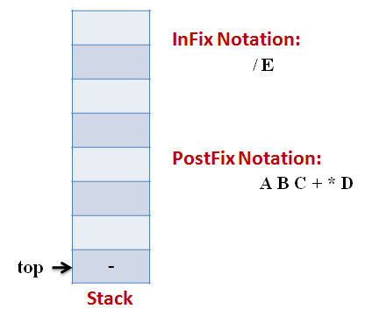
Example
Stage 10
Next, Operand ‘D‘ gets appended to the output.

Slide 21
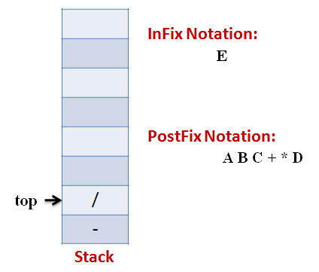
Example
Stage 11
Next, we will insert the division operator into the Stack because its precedence is more than that of minus.

Slide 22
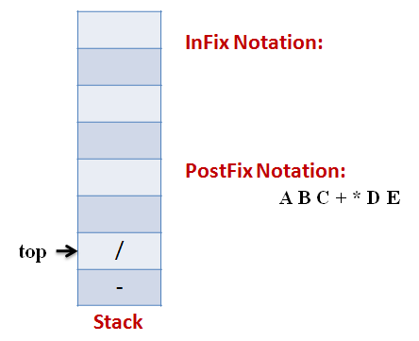
Example
Stage 12
The last token, E, is an operand, so we insert it to the output Expression as it is.

Slide 23
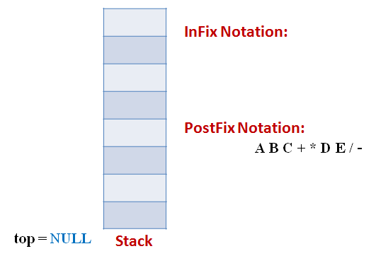
Example
Stage 13
The input Expression is complete now. So we pop the Stack and Append it to the Output Expression as we pop it.

Slide 24

Infix to postfix conversion
Stack
Infix Expression
( a + b - c ) * d – ( e + f )
Postfix Expression

Slide 25
Infix to postfix conversion
Stack
Infix Expression
a + b - c ) * d – ( e + f )
Postfix Expression
(

Slide 26
Infix to postfix conversion
Stack
Infix Expression
+ b - c ) * d – ( e + f )
Postfix Expression
a
(

Slide 27
Infix to postfix conversion
Stack
Infix Expression
b - c ) * d – ( e + f )
Postfix Expression
a
+
(

Slide 28
Infix to postfix conversion
Stack
Infix Expression
- c ) * d – ( e + f )
Postfix Expression
a b
+
(

Slide 29
Infix to postfix conversion
Stack
Infix Expression
c ) * d – ( e + f )
Postfix Expression
a b +
-
(

Slide 30
Infix to postfix conversion
Stack
Infix Expression
) * d – ( e + f )
Postfix Expression
a b + c
-
(

Slide 31
Infix to postfix conversion
Stack
Infix Expression
* d – ( e + f )
Postfix Expression
a b + c -

Slide 32
Infix to postfix conversion
Stack
Infix Expression
d – ( e + f )
Postfix Expression
a b + c -
*

Slide 33
Infix to postfix conversion
Stack
Infix Expression
– ( e + f )
Postfix Expression
a b + c - d
*

Slide 34
Infix to postfix conversion
Stack
Infix Expression
( e + f )
Postfix Expression
a b + c – d *
-

Slide 35
Infix to postfix conversion
Stack
Infix Expression
e + f )
Postfix Expression
a b + c – d *
(
-

Slide 36
Infix to postfix conversion
Stack
Infix Expression
+ f )
Postfix Expression
a b + c – d * e
(
-

Slide 37
Infix to postfix conversion
Stack
Infix Expression
f )
Postfix Expression
a b + c – d * e
+
(
-

Slide 38
Infix to postfix conversion
Stack
Infix Expression
)
Postfix Expression
a b + c – d * e f
+
(
-

Slide 39
Infix to postfix conversion
Stack
Infix Expression
Postfix Expression
a b + c – d * e f +
-

Slide 40
Infix to postfix conversion
Stack
Infix Expression
Postfix Expression
a b + c – d * e f + -

Slide 41
The End
……. Thank You ……..

